Slide 1

Transforming to Cloud Native
Pivotal Cloud Foundry Overview & Demo
Operations Key Role with Pivotal Cloud Foundry
Humana PCF Workshop: Operators Track
November 4th, 2015

Slide 2
Agenda
Transforming to Cloud Native
Why?
What?
How?
Pivotal Cloud Foundry Overview
PCF Demo: Application Push
Operations Key Role with Pivotal Cloud Foundry

Slide 3
WHY?

Slide 4
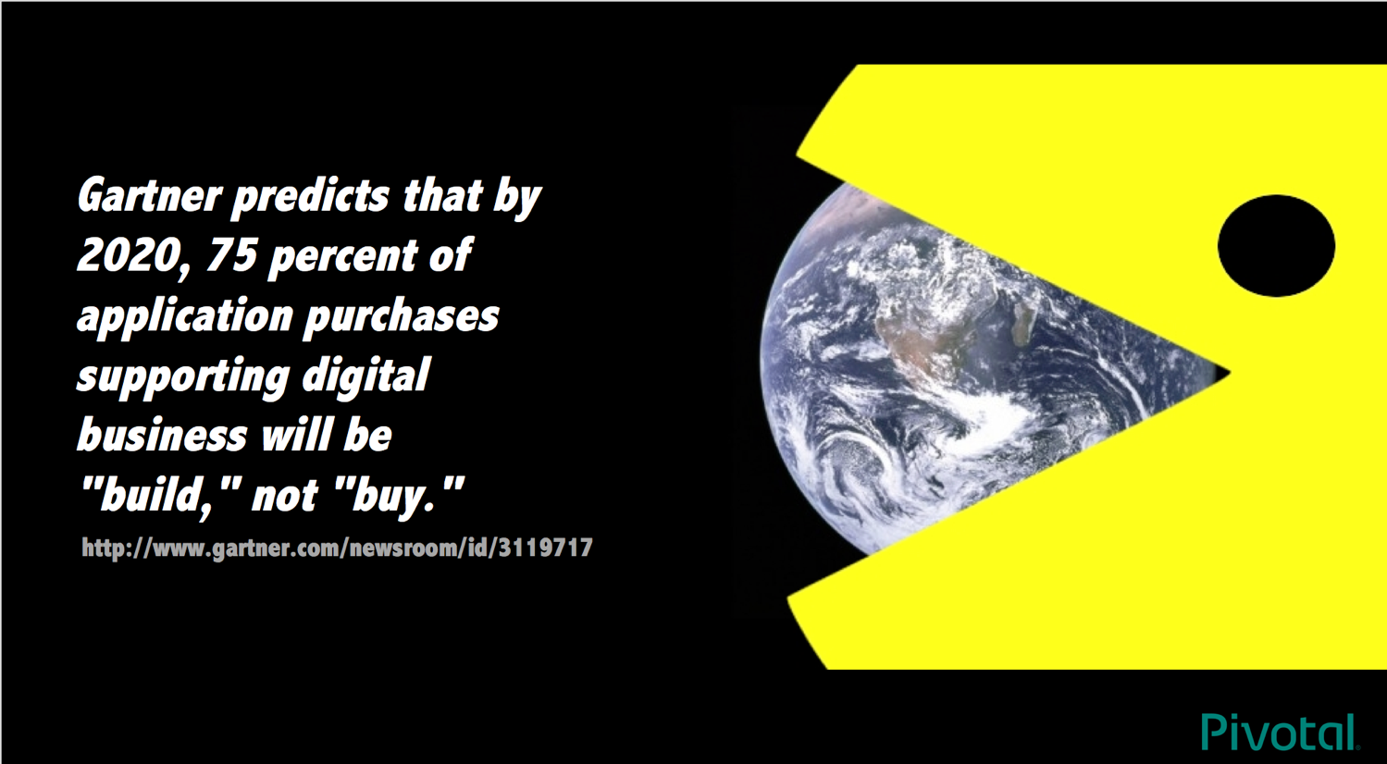

Slide 5

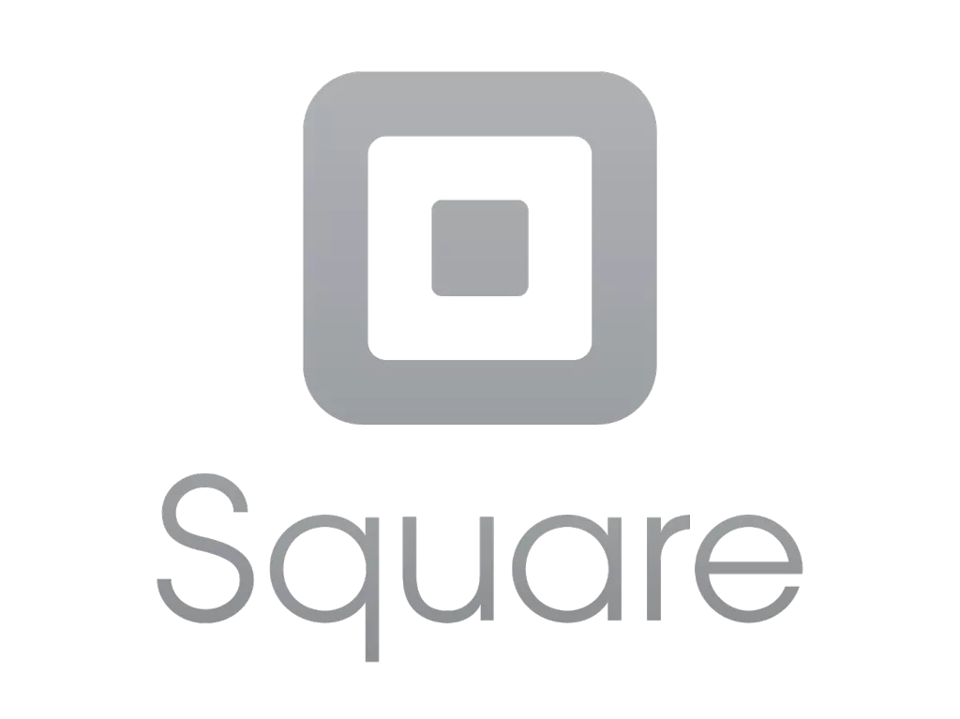
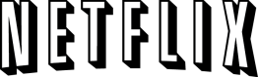

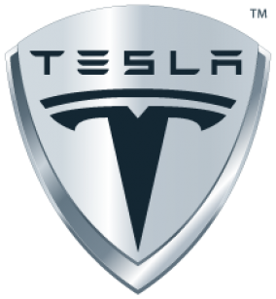
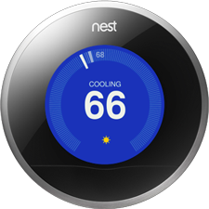
Software is changing industries

Slide 6
The promise of Cloud Native
Deploy new features daily to production
Automate middleware
Seamless horizontal scaling
Contract between App & Platform
Notes:
That is and should be a governing principle behind any cloud platform, library, or tool. Spring Cloud–an open-source library–makes it easy to develop JVM applications for the cloud. With it, applications can connect to services and discover information about the cloud environment easily in multiple clouds such as Cloud Foundry and Heroku. Further, you can extend it to other cloud platforms and new services.
Application Framework
Spring Cloud : used by Netflix
Spring Boot now over 1M downloads a month, historic levels of growth
Runtime platform
Cloud Foundry elastic runtime used by top FS leaders
Enterprise production ready Linux Container based platform
Infrastructure Automation
CF BOSH: Embedded OS, cloud API integrated
Incredible operational leverage; machine to machine automation

Slide 7
WHAT?

Slide 8
Characteristics of Cloud Native Architectures
Continuously Delivered
Twelve Factor Apps (http://12factor.net/)
Microservices
Self-Service agile infrastructure
API-based collaboration
Anti-fragility
Notes:
CD
- need to be able to deploy again and again w/o breaking stuff
- this is day 2 and day 3 story
- operational discipline is key to cloud native
- if you spend all of your $ on operating, then that takes away from deploying new software

Slide 9
WaterScrumFall
Production Release
#1
Waterfall Organization
Production Release
#2
Agile Development

Slide 10
Twelve-Factor Apps
Codebase
Dependencies
Configuration
Backing Services
Build, release, run
Processes
Port binding
Concurrency
Disposability
Dev/prod parity
Logs
Admin processes
APPS
contract
Cloud Platform
Architectural and development practices – http://12factor.net
Notes:
References:
http://12factor.net/
Architectural and development practices, that ensure an optimal experience on a cloud platform.
- describes contract - relationship between app and substrate it is running on

Slide 11
Microservice: Definition
If every service has to be updated in concert, it’s not loosely coupled!
“ Loosely coupled service oriented architecture with bounded contexts"
If you have to know about surrounding services you don’t have a bounded context.
- Adrian Cockcroft
Notes:
Loosely coupled: deploy and deliver new solutions in architecture w/o coordinating with other teams (must maintain existing contracts with other services in ecosystem)
Bounded Contexts: well define boundaries of service that is being deployed. Certain concepts cannot have agreed upon meanings with everyone in organization. Protect within scope of bounded context which has an API - what we know and how we can interact
- Adrian Cockroft's definition - previous cloud architect @ Netflix

Slide 12
Microservices are NOT
Monolithic Application
Service
Service
HTML
JavaScript
MVC
Enterprise Service Bus
Service
Service
OR
Data Access
Service
Service
Tightly Coupled
Centralized
Notes:
SOA
Forklift is hard
- maybe you've tried to take legacy apps and shove them into docker container
- because of implicit, poorly understood contracts between components
- cannot build microservices same way we build legacy apps

Slide 13







Microservice Architecture
Relational
DB
HTTP
HTTP
Key/Value
Store
HTTP
HTTP
HTTP
…
AMQP
AMQP
HTTP
Graph
DB
Notes:
REST and message-driven services
Polyglot persistence, services encapsulate data store semantics
Diversity of clients acknowledged
API Gateway for service aggregation, reduce chattiness, protocol translation, reduce latency/round-trips, deal with mobile device fragmentation, build use case/device specific API’s

Slide 14
It takes a platform
An end-to-end platform that makes implementing distributed application best practices, a turn-key and first practice
Notes:
Inverse Conway Maneuver coined by Thoughtworks - http://jonnyleroy.com/2011/02/03/dealing-with-creaky-legacy-platforms/
Goal is to create self contained, business aligned teams with the smallest feedback loop.
Business capability teams interact with platform operations team via APIs and not meetings. This creates a friction free experience for the business capability team who now have the tools to

Slide 15

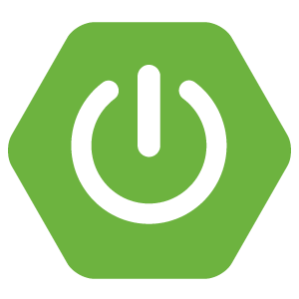
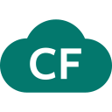
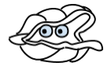
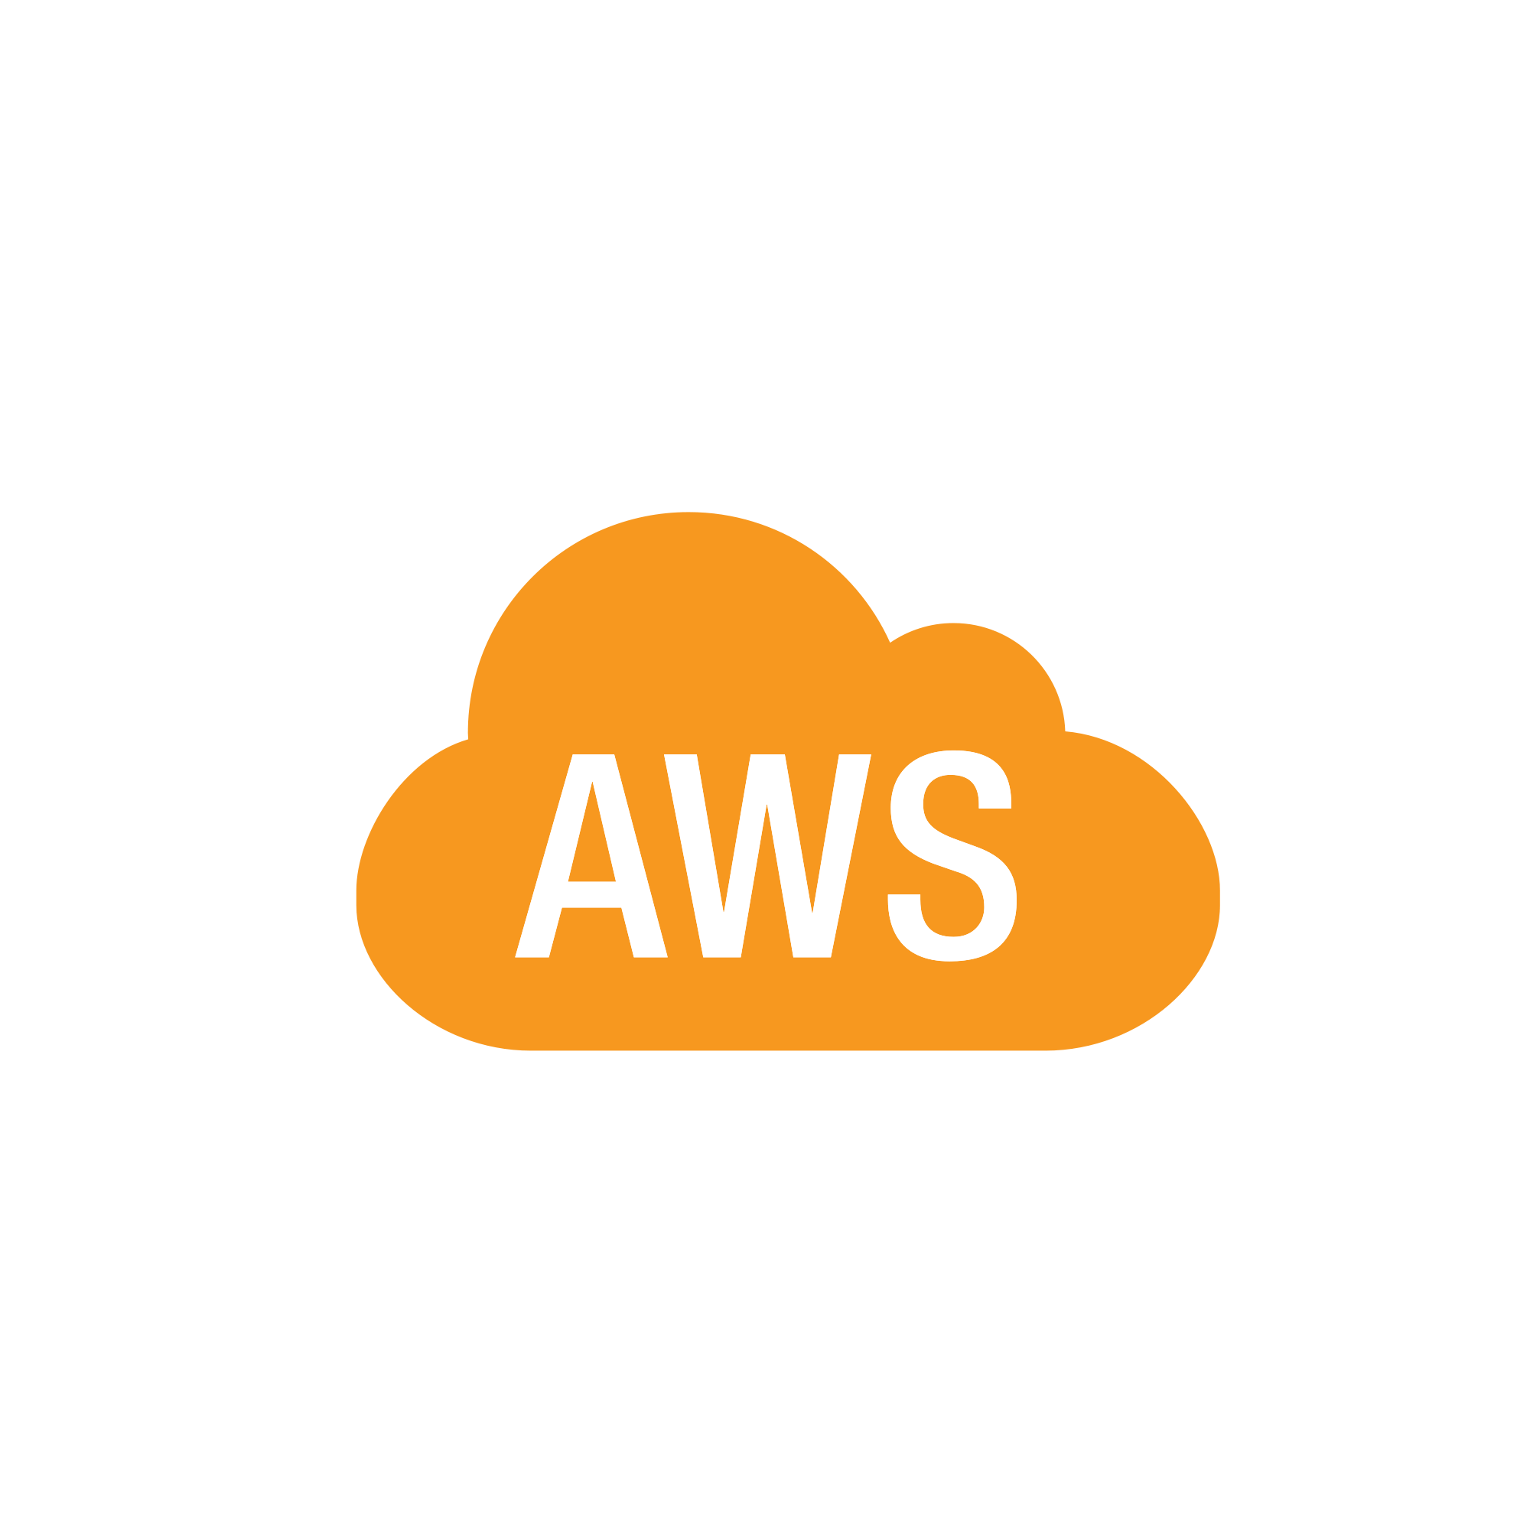
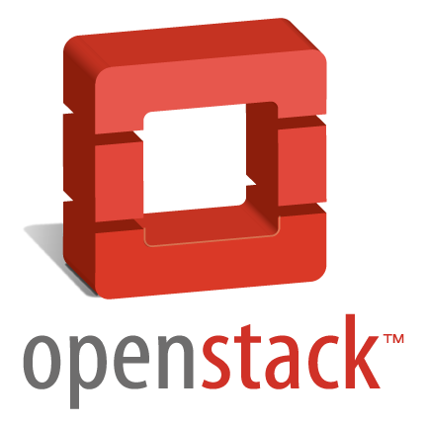
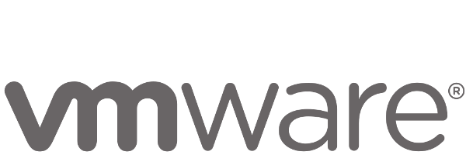
Anatomy of a Cloud Native Platform
1. Application Framework
Developer
Contract – 12 Factor App
2. Container Runtime
Dev+Ops
Contract – BOSH Release
IT Ops
3. Infrastructure Automation
Contract – Cloud Provider Interface
4. Infrastructure
IT Ops
“Contracts” between Applications, opinionated frameworks like Spring Boot and Spring Cloud and opinionated Cloud Native Platforms like Cloud Foundry help significantly accelerate the development of Cloud Native applications
Notes:
That is and should be a governing principle behind any cloud platform, library, or tool. Spring Cloud–an open-source library–makes it easy to develop JVM applications for the cloud. With it, applications can connect to services and discover information about the cloud environment easily in multiple clouds such as Cloud Foundry and Heroku. Further, you can extend it to other cloud platforms and new services.
Application Framework
Spring Cloud : used by Netflix
Spring Boot now over 1M downloads a month, historic levels of growth
Runtime platform
Cloud Foundry elastic runtime used by top FS leaders
Enterprise production ready Linux Container based platform
Infrastructure Automation
CF BOSH: Embedded OS, cloud API integrated
Incredible operational leverage; machine to machine automation

Slide 16
1. Application Framework
Spring
#1 Enterprise Java App Framework
Netflix
Open Source
Spring Boot
Quick Start
Little to no config.
Opinionated View
Spring Cloud
Distributed Config
Service Registration and Discovery
Routing/Load Balancing
Service Integration
Fault Tolerance
Pivotal is the main custodian of Spring and we hire the main committers for Spring Boot and Spring Cloud. We can bring these resources to bear to help significantly accelerate a customer’s journey to becoming a Cloud Native enterprise
Notes:
Spring Boot
1) Takes out elbow grease in initial config and dependency management of Spring Java app
2) spring team has taken years of knowledge of how to manage boilerplate config and bake into framework
3) start.spring.io - give it version of java, maven or gradle etc. and get a zip file for an app that is immediatley runnable
4) easily embed app containers like tomcat, jetty etc into jar file
5) gives you introspection endpoints to look at app traces, thread dumps, app metrics and health automatically configured
6) build app principles codified in 12 factor
Spring Cloud
Years of Distributed Systems Management gives us patterns
1) fault tolerance
2) service discovery
3) load balancing
4) config management
#1 Enterprise Java App Dev Framework
Used heavily by Netflix and F2000
OSS, Apache 2.0 licensed
Millions of downloads
Integrated into PCF, BDS

Slide 17
The Power of Cloud-Native Application Platforms
Business Value, Agility & Cost Savings
Traditional IT
IaaS
Cloud Native
You Manage
Applications
You Manage
Applications
Applications
Data
Data
Data
You Manage
Runtime
Runtime
Runtime
Middleware
Middleware
Middleware
Pivotal CF
+
Choice of IaaS
O/S
O/S
O/S
Virtualization
Virtualization
Virtualization
Servers
Servers
IaaS
Servers
Storage
Storage
Storage
Networking
Networking
Networking

Slide 18


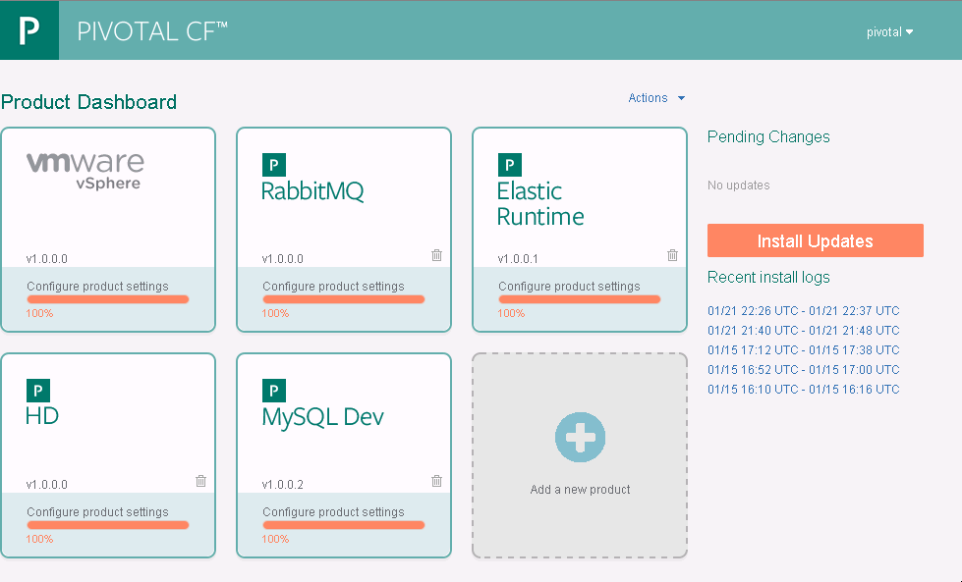

Continuous Delivery With PCF
Self-Service App Retirement
Everyone Pushes Code Daily (or more frequently)
Health Management and Four Levels of HA
SCC Integrated with CI for Automated Tests on Commit
Auto-Scaling
Zero-Downtime Platform Upgrades
Team(s) of Developers Working on Local Systems
Blue-Green Deployment Model for Zero Downtime App Upgrades
DEV
STAGE
UAT
PROD
Instant Feedback, Status and Logging
Artifacts Uploaded
Built-In CI Integration and Robust API for Scripting
Build Once, Stage Multiple Times with Automated Promotions

Slide 19

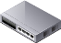
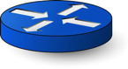
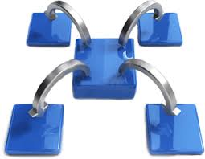
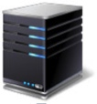

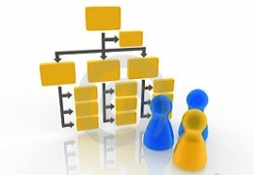




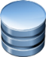




Pivotal CF: Technical Capabilities
Automatic App Server & OS Configuration with Buildpacks (“just push your app”)
Application
Containerization & Cluster Scheduling
Application Network Security Groups
App Health Management, Load Balancing,
Rapid Scaling, Availability Zones
Application to Services Binding and Access
Policy, Identity and Roles Management
Logging as a service,
Application metrics & performance,
Metric based scaling
Native & Extended Data, Mobile and Platform Services
IaaS Provisioning, Scaling & Configuration
Deploy, Operate, Update & Scale with minimal downtime on choice of IaaS
Notes:
Key Platform Capabilities
On Demand Scaling
Fault Tolerance & Application Health Management
Easy Upgrades
Buildpacks, Stem Cells, Service Brokers
Dynamic Routing & Load Balancing
Log and Metric Aggregation
Security
Production Ready and Fully Supported
WHAT
Pivotal CF is next generation middleware that delivers 9 things that are typically delivered via point software products.
We provision operating systems and middleware.
We deliver workload density without compromising application performance.
We ensure that applications have appropriate network security safe guards to prevent security threats.
We support application connections to external sources including databases and legacy middleware.
We provide 4 levels of HA, with built in load balancing for scale in/out
We support multi-tenant environments so that each line of business can operate with a discrete quota and isolated system access.
We provision next generation data services including NOSQL databases, traditional databases and hadoop clusters.
We provide horizontal and vertical scaling for the underlying IaaS so that you can scale your infrastructure in lock step with your Business.
We provide a built-in log aggregation service, built-in APM metrics and utilization based auto-scaling so that you can monitor the health of your applications and scale out without human or 3rd party tool intervention.
I am going to cover each of these 9 capabilities in more detail, but it’s important to note the impact of this collection of capabilities. The following slides will include information on CAPEX and OPEX reduction. We will also discuss how you can deliver faster time to value while holding the line on infrastructure cost.

Slide 20





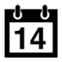


Cloud Foundry Architecture
Internet
HA Proxy LB
The Cloud Foundry platform is abstracted as a set of large-scale distributed services. It uses BOSH to operate the underlying infrastructure from IaaS providers (e.g., VMware, Amazon AWS, OpenStack).
Dynamic Router
Cloud Controller
UAA/Login Servers
Health Manager
Service Broker Node(s)
DEA Pool
Apps
Service Broker(s) – Bind internal/external Services to Applications
DEA – “Droplet Execution Agent”. Secure and fully isolated containers responsible for an App’s lifecycle: building, starting and stopping Apps as instructed.
User Provided
Service Instances
Build Packs
PaaS
Logging
Messaging (NATS)
Cloud Foundry BOSH
Underlying
Infrastructure
Notes:
Cloud Foundry PaaS
An application runs in a DEA, which is a droplet execution agent. The Cloud Controller orchestrates the routing and lifecycle of all DEAs in the pool. Routers manage application traffic. Health Manager reports mismatched application states to the CC. A service gateway provides an interface for services (native or external). A messaging bus manages all system communication. Apps are accessed directly through the router while web and CLI clients (e.g., vmc, STS) access Cloud Controller via RESTful services.

Slide 21
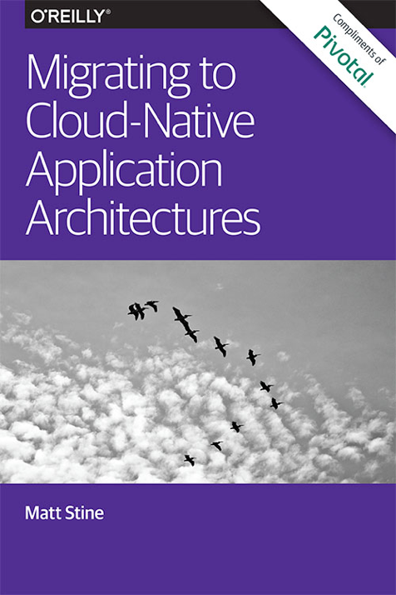
Matt wrote a little cloud book…
Available to you
compliments of Pivotal and O’Reilly!
Get the FREE e-book
at http://bit.ly/cloud-native-book!
Notes:
Which incidentally I wrote a little book on, and we’re going to sign and give those away here in the Hang Space at 10 o’clock.

Slide 22
Pivotal Cloud Foundry
Architecture & Containers

Slide 23
Cloud Native Application Platforms
Business Value, Agility & Cost Savings
Traditional IT
IaaS
Cloud Native
You Manage
Applications
You Manage
Applications
Applications
Data
Data
Data
You Manage
Runtime
Runtime
Runtime
Middleware
Middleware
Middleware
Pivotal CF
+
Choice of IaaS
O/S
O/S
O/S
Virtualization
Virtualization
Virtualization
Servers
Servers
IaaS
Servers
Storage
Storage
Storage
Networking
Networking
Networking

Slide 24
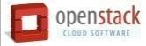

Pivotal CF: Technical Capabilities
Automatic App Server & OS Configuration with Buildpacks (“just push your app”)
Application
Containerization & Cluster Scheduling
Application Network Security Groups
App Health Management, Load Balancing,
Rapid Scaling, Availability Zones
Application to Services Binding and Access
Policy, Identity and Roles Management
Logging as a service,
Application metrics & performance,
Metric based scaling
Native & Extended Data, Mobile and Platform Services
IaaS Provisioning, Scaling & Configuration
Deploy, Operate, Update & Scale with minimal downtime on choice of IaaS
Notes:
Key Platform Capabilities
On Demand Scaling
Application Health Management
Dynamic Routing & Load Balancing
Log and Metric Aggregation
Security
WHAT
Pivotal CF is next generation middleware that delivers 9 things that are typically delivered via point software products.
We provision operating systems and middleware.
We deliver workload density without compromising application performance.
We ensure that applications have appropriate network security safe guards to prevent security threats.
We support application connections to external sources including databases and legacy middleware.
We provide 4 levels of HA, with built in load balancing for scale in/out
We support multi-tenant environments so that each line of business can operate with a discrete quota and isolated system access.
We provision next generation data services including NOSQL databases, traditional databases and hadoop clusters.
We provide horizontal and vertical scaling for the underlying IaaS so that you can scale your infrastructure in lock step with your Business.
We provide a built-in log aggregation service, built-in APM metrics and utilization based auto-scaling so that you can monitor the health of your applications and scale out without human or 3rd party tool intervention.
I am going to cover each of these 9 capabilities in more detail, but it’s important to note the impact of this collection of capabilities. The following slides will include information on CAPEX and OPEX reduction. We will also discuss how you can deliver faster time to value while holding the line on infrastructure cost.

Slide 25
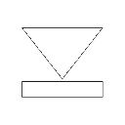

Pivotal CF Architecture
HA Proxy LB
Dynamic Router
Ops Manager UI
Service Broker
Cloud Controller
Health Manager
Service Nodes
Ops Manager Director
Operations Manager
UAA
Login Server
Service
DEA Pool
Service Broker
Build Packs
Build Packs
Service Nodes
Apps
Apps
Service
Messaging (NATS)
Metrics Collection
App Log Aggregator
Elastic Runtime
Notes:
The Cloud Foundry platform is abstracted as a set of large-scale distributed services. It uses BOSH to operate the underlying infrastructure from IaaS providers (e.g., VMware, Amazon AWS, OpenStack).
Service Broker(s) – Bind internal/external Services to Applications
DEA – “Droplet Execution Agent”. Secure and fully isolated containers responsible for an App’s lifecycle: building, starting and stopping Apps as instructed.

Slide 26
Staging and Buildpacks
Buildpacks are responsible for preparing the machine image for an application.
}
Application
Buildpack
Container
Libraries
Droplet
DEA
Runtime
Operating System

Slide 27
Buildpacks
Buildpacks installed into a Cloud Foundry instance or loaded from an external location at app deployment time
Buildpacks provided by public Cloud Foundry
Cloud Foundry Community Buildpack
Write you own
Java
Ruby
Node.js
Go
Python
PHP
Notes:
Java
Ruby
Node.js
Custom Build packs

Slide 28
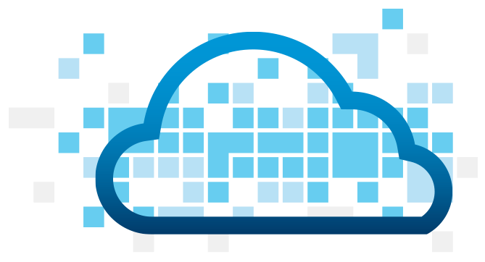
Application Staging
Blobstore
DB
Cloud Controller
Router
DEA
System
Buildpacks
Detect
Compile
Upload
Yes
No
+
=
Runtime
Notes:
Cloud Foundry PaaS
An application runs in a DEA, which is a droplet execution agent. The Cloud Controller orchestrates the routing and lifecycle of all DEAs in the pool. Routers manage application traffic. Health Manager reports mismatched application states to the CC. A service gateway provides an interface for services (native or external). A messaging bus manages all system communication. Apps are accessed directly through the router while web and CLI clients (e.g., vmc, STS) access Cloud Controller via RESTful services.

Slide 29

Overview: Pushing an Application
Blobstore
Service
credentials
Upload app bits and metadata
DB
push app
+ app MD
Cloud Controller
Service Broker Node(s)
Create and bind services
Stage application
Deploy application
Manage application health
Router
DEA
DEA
DEA
DEA
+
=
Runtime
Notes:
Cloud Foundry PaaS
An application runs in a DEA, which is a droplet execution agent. The Cloud Controller orchestrates the routing and lifecycle of all DEAs in the pool. Routers manage application traffic. Health Manager reports mismatched application states to the CC. A service gateway provides an interface for services (native or external). A messaging bus manages all system communication. Apps are accessed directly through the router while web and CLI clients (e.g., vmc, STS) access Cloud Controller via RESTful services.

Slide 30


D e m o
Notes:
(bold moves)
2015 – This is..
The year where we see a level of adoption of our products and services that propels us to becoming an ipo-worthy company
This is..the year where our great vision becomes a reality in production environments at the most important companies and organizations in the world.
This is the year that we show and teach our customers and partners the power and opportunity that building great software brings.

Slide 31

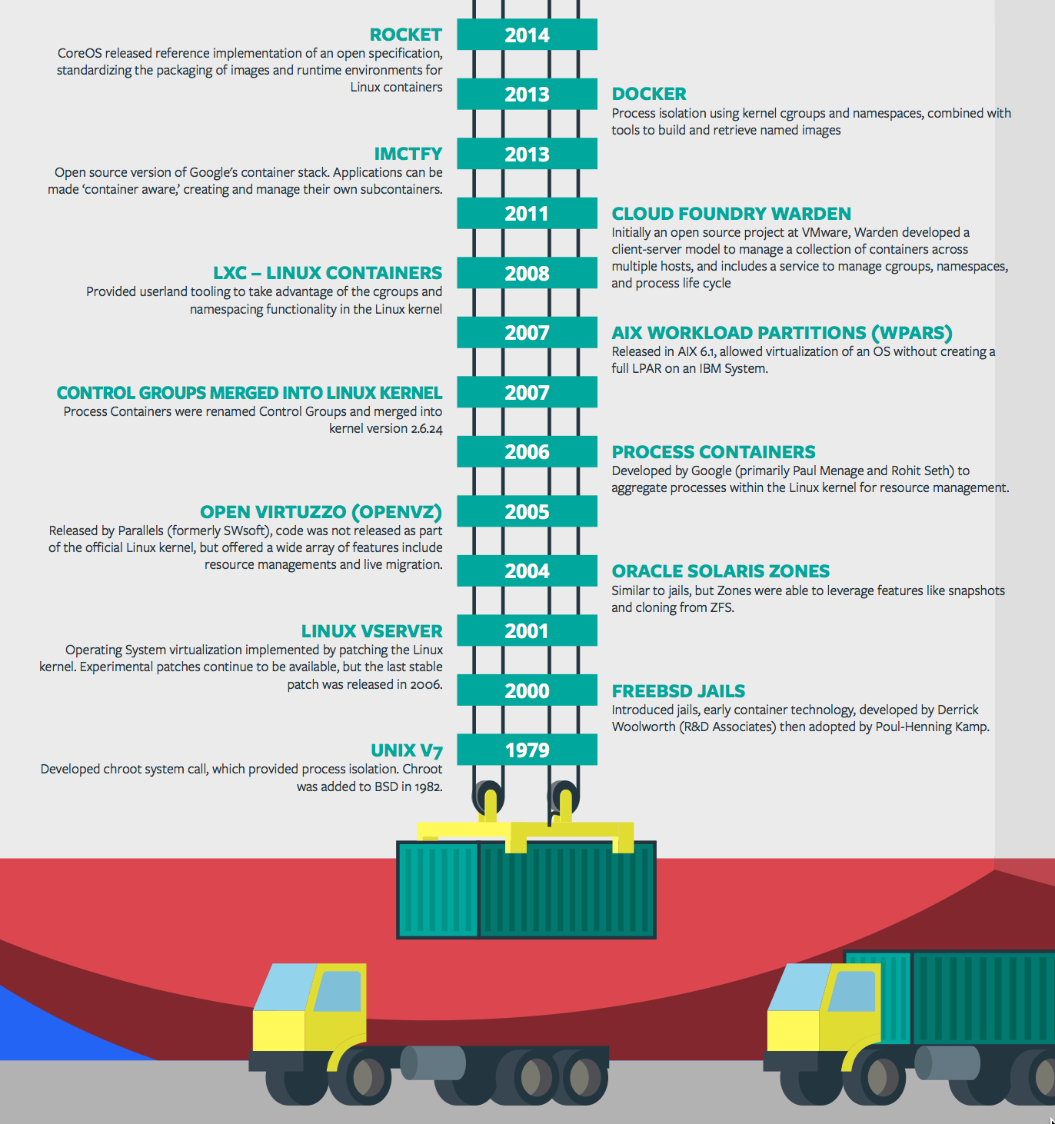
Containers - History
CONTAINERS!!!!
Containers are not new
CF has used containers since it’s inception
CF supports multiple container technologies as first class citizens including Docker, Warden, Garden and runC
Notes:
History of Docker
- 2006 Google to use containers they built cgroups and namespaces and pushed it to the Linux kernel
- cgroups and namespaces give you isolation (Resource Isolation and Namespace isolation)
- dotCloud and LXC fragmentation
- libcontainer created to address application portability and standard API across linux distros BUT controlled by Docker
- Open Container Project (Docker/dockerfile, CoreOS/appc). Standardiized on runC
- Standardizing the file format (dockerfile + appc = filesystem)
- Standardizing the runtime (libcontainer = runC)
- Container (Isolation + Files/metadata + Processes)

Slide 32
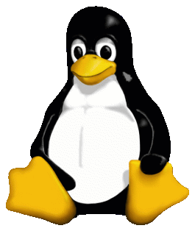
Container Isolation
shared resources
resource isolation
kernel
namespace isolation
process F
process A
process E
process B
process D
process C
tenant 1
tenant 2
tenant 3

Slide 33


Container Isolation
CPU
resource isolation
namespace isolation
cgroups
process D
process F
process F
process E
process A
process E
process B
process D
process C
tenant 1
tenant 2
tenant 3

Slide 34
Container Isolation
PID
2
3
4
2
2
3
resource isolation
namespace isolation
PID namespace
process F
process A
process E
process B
process D
process C
tenant 1
tenant 2
tenant 3

Slide 35
Container Isolation
shared resources
resource isolation
kernel
namespace isolation
namespaces
PID
process F
process A
process E
process B
process D
process C
Network
Mount
User
tenant 1
tenant 2
tenant 3

Slide 36
Application containers and scaling
Blobstore
Cloud Controller
Messaging (NATS)
Router
Access App
DEA
DEA
DEA
Runtime
Notes:
Cloud Foundry PaaS
An application runs in a DEA, which is a droplet execution agent. The Cloud Controller orchestrates the routing and lifecycle of all DEAs in the pool. Routers manage application traffic. Health Manager reports mismatched application states to the CC. A service gateway provides an interface for services (native or external). A messaging bus manages all system communication. Apps are accessed directly through the router while web and CLI clients (e.g., vmc, STS) access Cloud Controller via RESTful services.

Slide 37
Customize the container experience
Buildpack
Docker
Developer brings customized app
Developer brings customized app
Buildpack brings standard runtime*
Developer brings runtime docker image
System stack brings fixed OS container image
Developer brings Docker OS image
System brings fixed host OS Kernel
System brings fixed host OS Kernel
App container
* Devs may bring a custom buildpack

Slide 38
Pivotal Cloud Foundry
Services

Slide 39
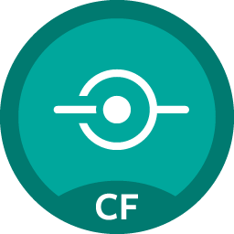
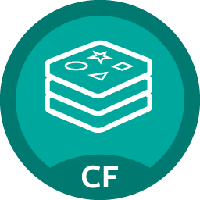
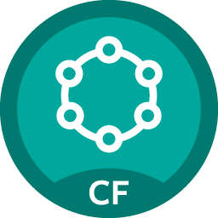
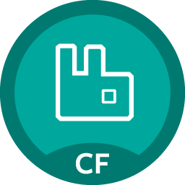
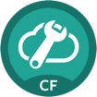
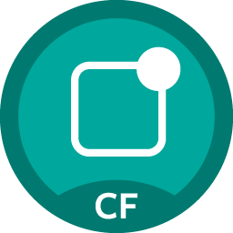
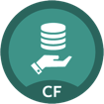
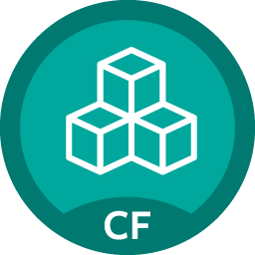
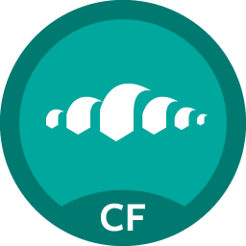
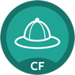
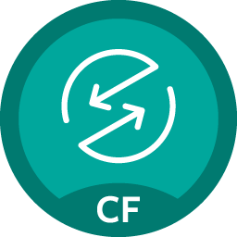

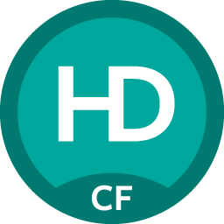
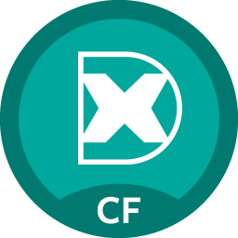
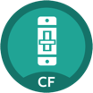

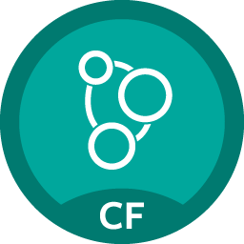
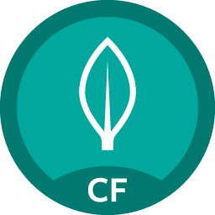

Pivotal Cloud Foundry Services
Mobile
Data
Other
Spring Cloud
API Gateway
Redis
DataStax Cassandra
Config Server
RabbitMQ
Push Notification
MySQL
GemFire
Jenkins Enterprise
Service Directory
Data Sync
Session state caching
Circuit Breaker
PivotalHD
Spring XD
App Distribution
Single Sign-on
Neo4j
MongoDB

Slide 40
Creating and Binding a Service
Service
credentials
DB
CLI
create service (HTTP)
Cloud Controller
create service (HTTP)
Service
Broker
reserve resources
Data
Service
Router
bind service (HTTP)
bind service (HTTP)
obtain connection data
Runtime
Notes:
Cloud Foundry PaaS
An application runs in a DEA, which is a droplet execution agent. The Cloud Controller orchestrates the routing and lifecycle of all DEAs in the pool. Routers manage application traffic. Health Manager reports mismatched application states to the CC. A service gateway provides an interface for services (native or external). A messaging bus manages all system communication. Apps are accessed directly through the router while web and CLI clients (e.g., vmc, STS) access Cloud Controller via RESTful services.

Slide 41
Pivotal CF Architecture - Recap
HA Proxy LB
Dynamic Router
Ops Manager UI
Service Broker
Cloud Controller
Health Manager
Service Nodes
Ops Manager Director
Operations Manager
UAA
Login Server
Service
DEA Pool
Service Broker
Build Packs
Build Packs
Service Nodes
Apps
Apps
Service
Messaging (NATS)
Metrics Collection
App Log Aggregator
Elastic Runtime
Notes:
The Cloud Foundry platform is abstracted as a set of large-scale distributed services. It uses BOSH to operate the underlying infrastructure from IaaS providers (e.g., VMware, Amazon AWS, OpenStack).
Service Broker(s) – Bind internal/external Services to Applications
DEA – “Droplet Execution Agent”. Secure and fully isolated containers responsible for an App’s lifecycle: building, starting and stopping Apps as instructed.

Slide 42
Pivotal Cloud Foundry
Operations

Slide 43


Pivotal CF operations
Developer
Operator

Slide 44

Deploy to dev

Slide 45
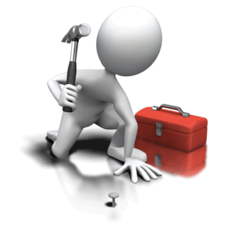
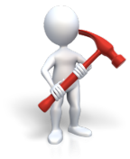
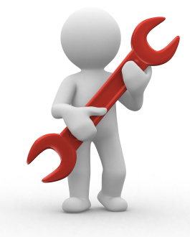



Install runtime and container
Deploy to dev
Install services (db,
messaging, hadoop, …)
Setup load-balancing, SSL termination and dynamic routing
Setup / config High Availability
Setup APM
Setup log streaming

Slide 46

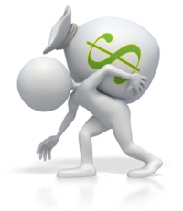


Install runtime and container
Deploy to dev
Install services (db,
messaging, hadoop, …)
Setup load-balancing, SSL termination and dynamic routing
Setup / config High Availability
App Deployed
Setup APM
Setup log streaming

Slide 47
Blue-green deployment
Restart server
Upgrade app
Install runtime and container
Deploy to Test
Create service
Deploy to dev
Change JDK
Redeploy
Install services (db,
messaging, hadoop, …)
Scale Platform
Scale up
Bind service
Update app
Setup load-balancing and dynamic routing
Deploy to QA
Update app server
Unbind service
Setup / config High Availability
Change route
Promote to production
Setup APM
Escale memory
Check logs
Setup log streaming
Scale down
Delete App

Slide 48

Blue-green deployment
Restart server
Upgrade app
Install runtime and container
Deploy to Test
Create service
Change JDK
Deploy to dev
Redeploy
Install services (db,
messaging, hadoop, …)
Scale Platform
Scale up
Bind service
Update app
Setup load-balancing and dynamic routing
Deploy to QA
Update app server
Unbind service
Setup / config High Availability
Change route
Promote to production
Setup APM
Escale memory
Check logs
Setup log streaming
Scale down
Delete App

Slide 49

The Pivotal CF way
Deploy to dev

Slide 50





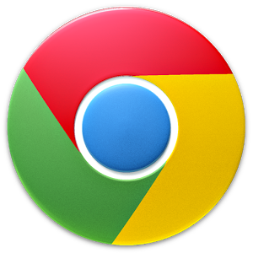


The Pivotal CF way
Deploy to dev
Cloud
Controller
Health Manager
> cf push
NATS
(message bus)
App Deployed
Router
Router

Slide 51


The operator in the PaaS era

Slide 52



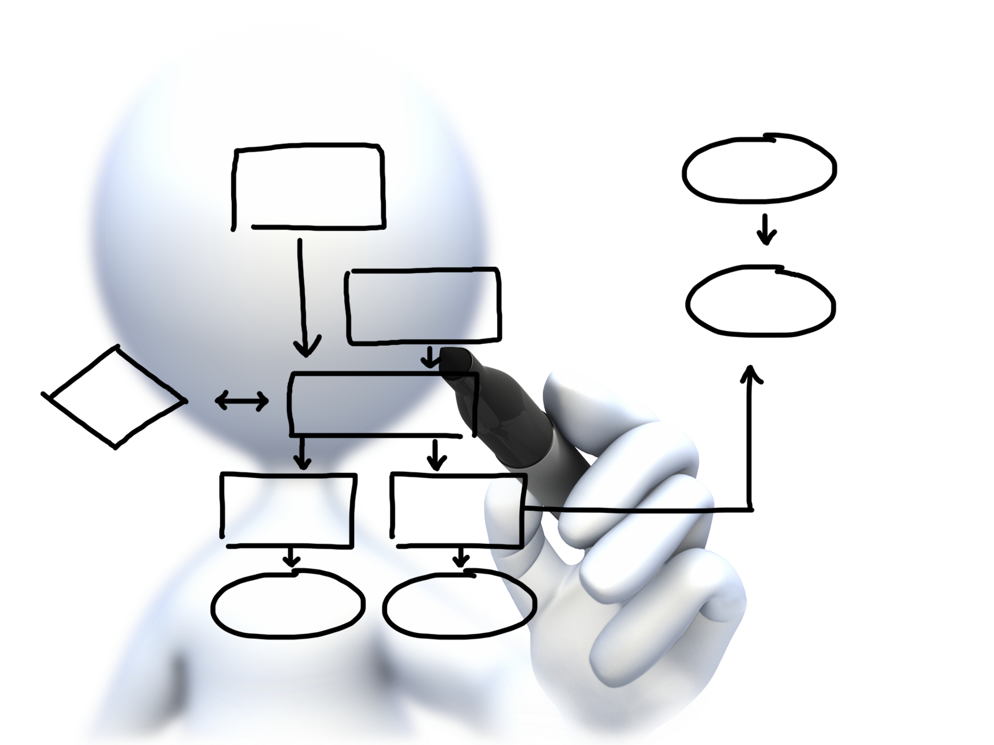


Plan capacity
Setup High Availability
Install the platform
Operator Concerns
Manage users
and quotas
Handle upgrades and updates
Monitor the platform

Slide 53






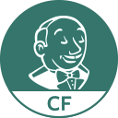


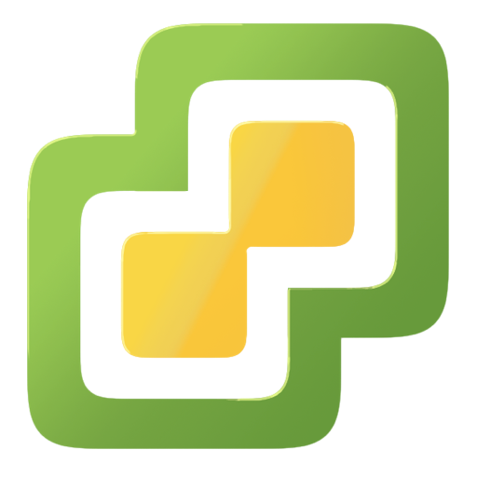
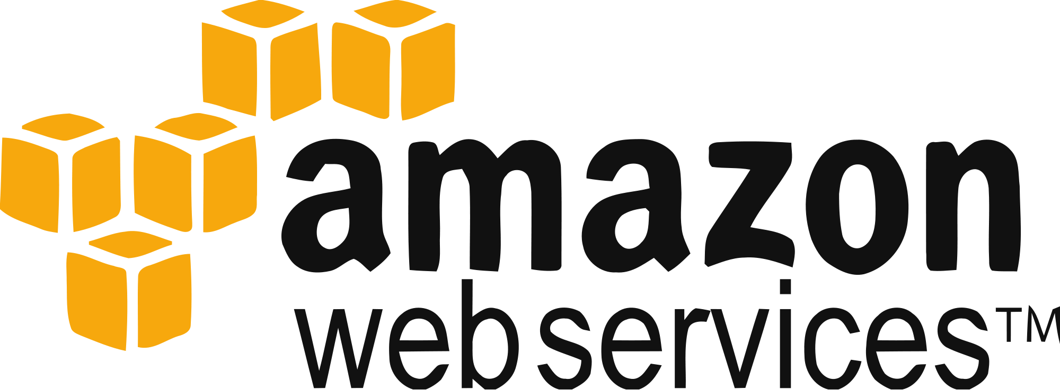



Install the platform
Setup High Availability
Pivotal CF
Install and manage services
Target multiple clouds
IaaS
Handle live upgrades and updates
Scale and
plan capacity

Slide 54












Click to install
No downtime updates
Explore install logs
Click to scale the platform
CloudBees Jenkins
Enterprise
Built-in High Availability
Cassandra
for Pivotal CF
Built-in Platform Monitoring
ElasticSearch
for Pivotal CF
Mobile Services
for Pivotal CF
BOSH Director
BOSH Agent
Integrated services
IaaS

Slide 55



Ops Manager + BOSH
IaaS
DB
BOSH
Deploy my
Services
BOSH Director
Worker VMs
Blobstore
NATS
Messaging
Health Manager
Health
Monitor
Cloud Controller
Target VM

Slide 56

Plan capacity
Setup High Availability
Install the platform
Operator Concerns
Manage users
and quotas
Handle upgrades and updates
Monitor the platform

Slide 57

Orgs, Spaces, Users and Quotas

Slide 58
Organizations
Logical division within a Pivotal CF install / Foundation.
Each organization has its own users and assigned quota
User permissions / roles are specified per space within an organization
Sub-divided into Spaces

Slide 59

Quotas and Plans
Different quota limits (e.g. “small”, “enterprise”, “default”, “runaway”) can be assigned per Organization
Quota defines
Total Memory
Total # of Services
Total # of Routes

Slide 60

Spaces
Logical sub-division within an organization
Users authorized at an organization level can have different roles per space
Services and Applications are created / specified per Space
Same Service can have different meanings per space

Slide 61
Plan capacity
Setup High Availability
Install the platform
Operator Concerns
Manage users
and quotas
Handle upgrades and updates
Monitor the platform

Slide 62
Platform Monitoring
How do I know when to scale DEAs?
How many requests each Router is servicing?
What is the current load of my Cloud Controllers?

Slide 63
Platform Monitoring
Pivotal Ops Metrics provides a single JMX interface to access metrics for each Pivotal CF component
DEAs
Cloud Controllers
Routers
Health Managers
NATS, UAA, Login Server, …

Slide 64



Platform Monitoring
JMX Monitoring Tool
JMX Provider
Collector

Slide 65
Plan capacity
Setup High Availability
Install the platform
Operator Concerns
Manage users
and quotas
Handle upgrades and updates
Monitor the platform

Slide 66
4 Layers of built-in High Availability
Application Instance
Platform Processes
Platform VMs
Availability Zones

Slide 67
App Instance HA
Desired State
Actual State
Blobstore
Cloud Controller
Health Manager
Messaging (NATS)
Router
DEA
DEA
DEA
Runtime
Notes:
Cloud Foundry PaaS
An application runs in a DEA, which is a droplet execution agent. The Cloud Controller orchestrates the routing and lifecycle of all DEAs in the pool. Routers manage application traffic. Health Manager reports mismatched application states to the CC. A service gateway provides an interface for services (native or external). A messaging bus manages all system communication. Apps are accessed directly through the router while web and CLI clients (e.g., vmc, STS) access Cloud Controller via RESTful services.

Slide 68

Platform Processes HA
BOSH
Pivotal CF
DB
DEA
Agent
Process
BOSH Director
Health Manager
Blobstore
Process
Agent
Messaging
NATS
Agent
Process
Health
Monitor
Cloud Controller
Target VM
Agent
Process

Slide 69

Platform Processes HA
Target VM
Cloud Controller
Agent
Process
Restart

Slide 70
Platform VMs HA
BOSH
Pivotal CF
DB
Cloud Controller
Agent
Process
BOSH Director
Re-create VM
Health Manager
Blobstore
Process
Agent
Ressurector
VM is
missing…
Messaging
NATS
Agent
Process
Health
Monitor
Cloud Controller
Agent
Process

Slide 71
Availability Zones
Zone 1
Zone 2
System components and Application instances are evenly distributed over two availability zones.
DEA
DEA
DEA
DEA
Loosing an AZ keeps instances running and available.
Router
DEA
DEA
Runtime
Notes:
Zone could = rack, for example

Slide 72
How Pivotal CF enables four layers of HA
1.
2.
3.
4.
PCF
PCF
PCF
Zone 1
Zone 2
A
B
C
A
B
C
A
B
C
A
B
C
A
B
C
A
B
C
A
B
C
Process
VM1
VM2
VM3
B
B
B
B
3. Resurrector restarts failed VMs
VM1
VM2
B
A
B
C
A
B
C
A
B
C
A
B
C
OS,
Mware
OS,
Mware
OS,
Mware
B
B
B
B
If an app fails, PCF reboots app in a new container.
If a process fails, PCF restarts the process
If an OS or network failure occurs PCF kills the VM and reboots the host in a new Virtual machine.
If a datacenter rack fails, PCF ensures applications stay running in multiple availability zones
App Fail
Process Fail
VM Fail
Rack Fail
Notes:
Application performance and reliability have a direct correlation to HA capability. Pivotal provides 4 level of HA so that you don’t need to invest in people/software to handle common failure situations. If an application fails, we will reboot it in a new container. This automated remediation addresses application bugs that result in outages. If a Pivotal process fails, we will reboot it in a new virtual machine. Our PaaS essentially monitors and remediates itself. If an OS or network failure occurs, our VM monitor will detect this and kill the VM, then reboot it in a new container. This streamlines Linux sysadmin operations. Lastly, if a datacenter rack fails, we will ensure the application stays running because we load application instances in multiple availability zones. No 2 availability zones live on the same datacenter rack. This hardware failure level resilience is very difficult to design using traditional tools provided by HP/CA/IBM.
And, by using Pivotal, you reduce the number of servers that require HP/CA/IBM monitoring tools.
http://blog.pivotal.io/cloud-foundry-pivotal/products/the-four-levels-of-ha-in-pivotal-cf
Desired State of Application is maintained by Cloud Controller. DEAs communicate status of their apps to Health Manager. HM checks with CC. CC restarts app in another DEA in case of failure
PCF Processes monitored by monit and restarted in case of failure
In case of VM failure. Health Monitor is notified. HM calls BOSH Director which calls Resurrector component which starts up the VM (with processes)
Availability Zones is a logical grouping of the deployment of System Components and DEAs. (Example would be two racks in a datacenter)

Slide 73
Plan capacity
Setup High Availability
Install the platform
Operator Concerns
Manage users
and quotas
Handle upgrades and updates
Monitor the platform

